Slide 1
Distributed Computing Peer-to-Peer Computing and Overlay Graphs
Dr. Barsha Mitra
CSIS Dept, BITS Pilani, Hyderabad Campus

Slide 2
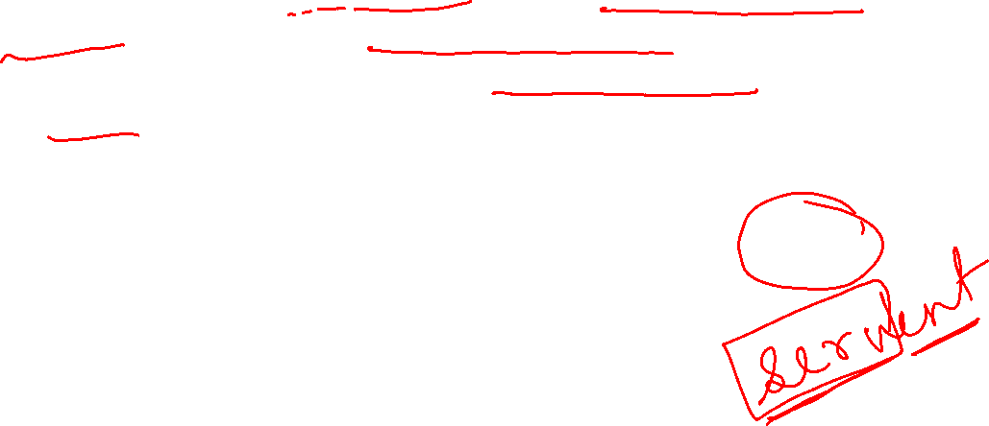
Introduction
allows for flexibly sharing resources (e.g., files and multimedia documents) stored across network-wide computers
any node in a P2P network can act as a server to others and also as a client
communication and exchange of information is performed directly between the participating peers
relationships between the nodes in the network are equal

Slide 3
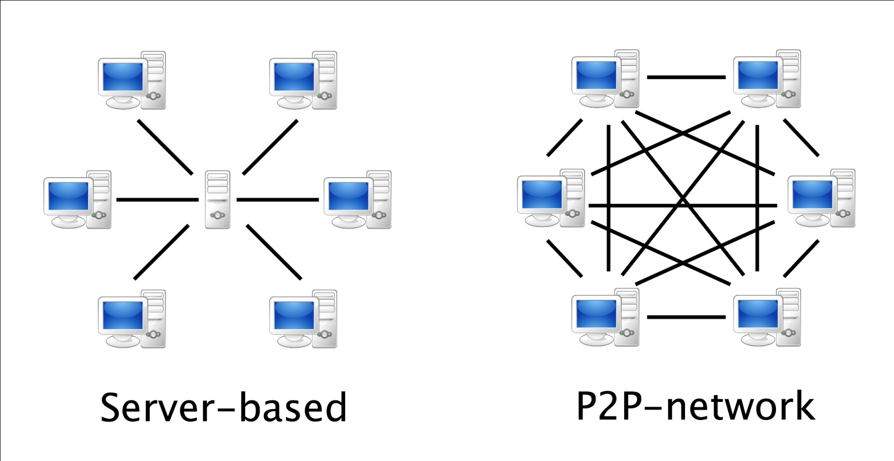
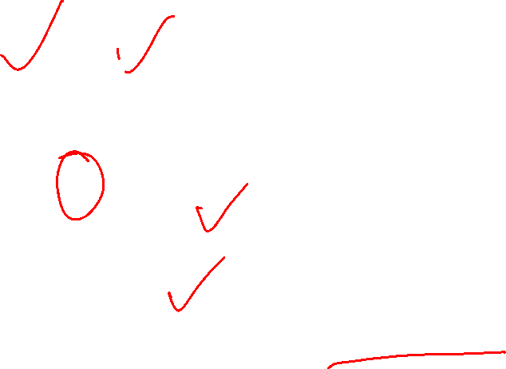
Introduction
source: http://www.terndrup.net/2015/10/27/Building-a-P2P-Peer-Client-with-Node-js/

Slide 4
Introduction
well known P2P networks that allow P2P file-sharing
Napster
Gnutella
Freenet
Pastry
Chord
CAN

Slide 5
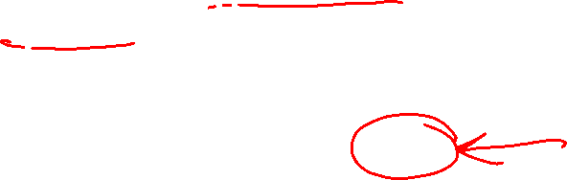
Introduction
P2P networks
allow the location of arbitrary data objects
impose a low cost for scalability, and for entry into and exit from the network
ongoing entry and exit of various nodes and dynamic insertion and deletion of objects is termed as churn
impact of churn should be as transparent as possible

Slide 6
Data Indexing and Overlays
data in a P2P network is identified by using indexing
indexing mechanisms can be classified as:
centralized
local
distributed

Slide 7
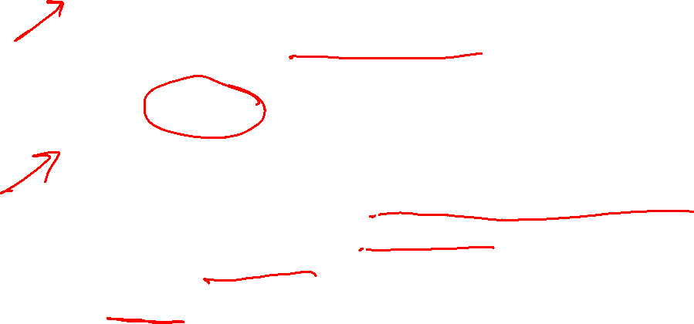
Data Indexing and Overlays
Centralized Indexing:
use of one or a few central servers to store references (indexes) to the data on many peers
eg. Napster
Local indexing:
requires each peer to index only the local data objects
remote objects need to be searched for
used in unstructured overlays
Gnutella uses local indexing

Slide 8
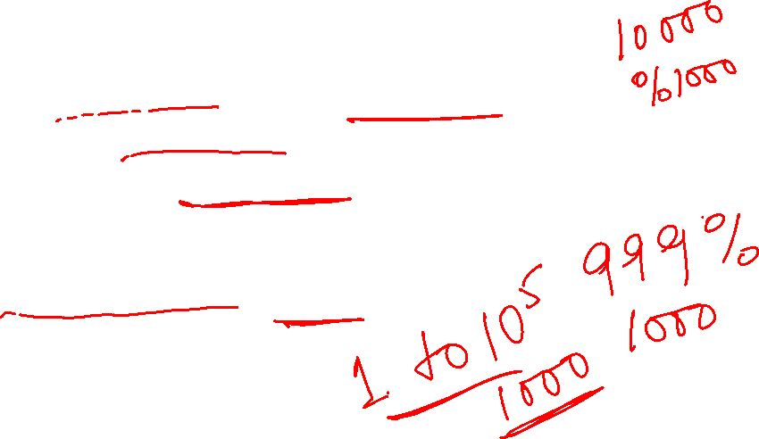
Data Indexing and Overlays
Distributed Indexing:
involves the indexes to the objects at various peers being scattered across other peers throughout the P2P network
distributed indexing is the most challenging of the indexing schemes
many novel mechanisms have been proposed, most notably the distributed hash table (DHT)

Slide 9

Structured Overlays
P2P network topology has a definite structure
placement of files or data in this network is highly deterministic as per some algorithmic mapping
use a hash table interface for the mapping
hash function maps keys to values
allows fast search for the location of a file
disadvantage of such mapping:
arbitrary queries such as range queries, attribute queries and exact keyword queries cannot be handled directly

Slide 10

Unstructured Overlays
P2P network topology does not have any particular controlled structure
no control over where files/data is placed
local indexing is used
file placement is not governed by the topology
search for a file may have high message overhead and high delays
queries may be unsuccessful even if the queried object exists
complex queries are supported because the search criteria can be arbitrary

Slide 11
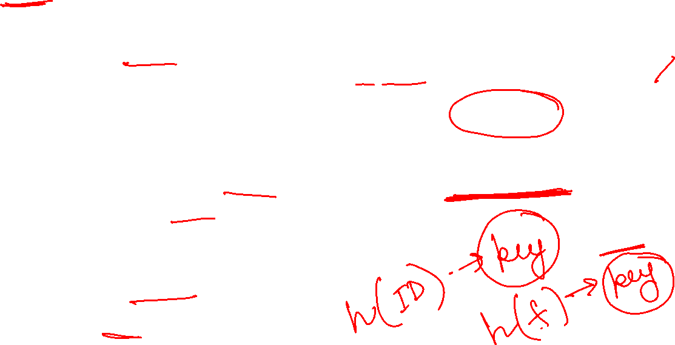
Chord distributed hash table: Overview
uses a flat key space to associate the mapping between network nodes and data objects/files/values
node address and data object/file/value is mapped to a logical identifier in the common key space using a hash function
equal distribution of keys among nodes

Slide 12

Chord distributed hash table: Overview
supports a single operation, lookup(x)
lookup(x) maps a given key x to a network node
Chord stores a file/object/value at the node to which the file/object/value’s key maps

Slide 13
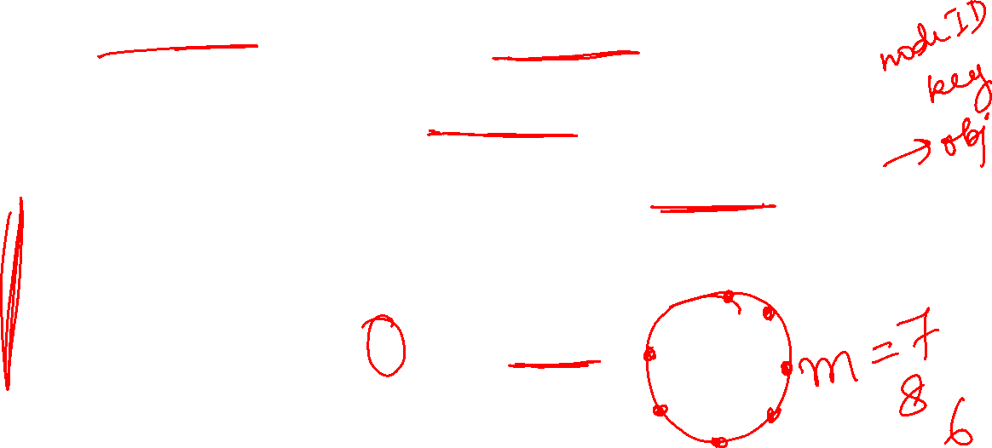

Chord distributed hash table: Overview
node’s IP address is hashed to an m-bit identifier that serves as the node identifier in the common key (identifier) space
file/data key is hashed to an m-bit identifier that serves as the key identifier
identifier space is ordered on the logical ring modulo 2^{m}
a key k gets assigned to the first node such that its node identifier equals or follows the key identifier of k in the common identifier space
node is the successor of k, denoted succ(k)

Slide 14
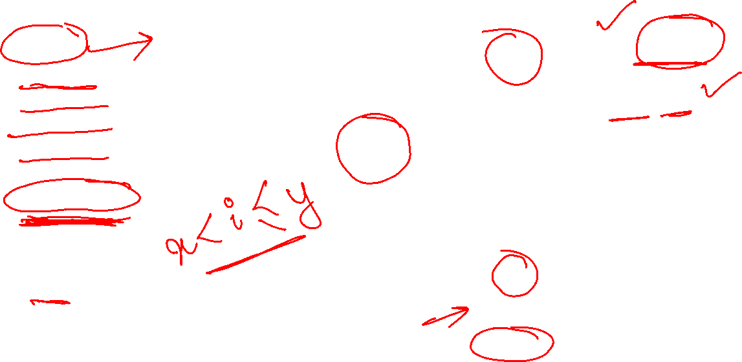
Chord distributed hash table: Overview
m = 7
succ(2) = 2
succ(10) = 13
succ(60) = 69
succ(65) = 69
succ(80) = 102
succ(125) = 2
succ(148) = 23
K2
K125
N123
N2
N8
K10
N115
N13
K80
N102
N23
N30
N75
Convention:
(x, y] → left-open right-closed segment of the Chord ring
N58
N69
K60
K65

Slide 15
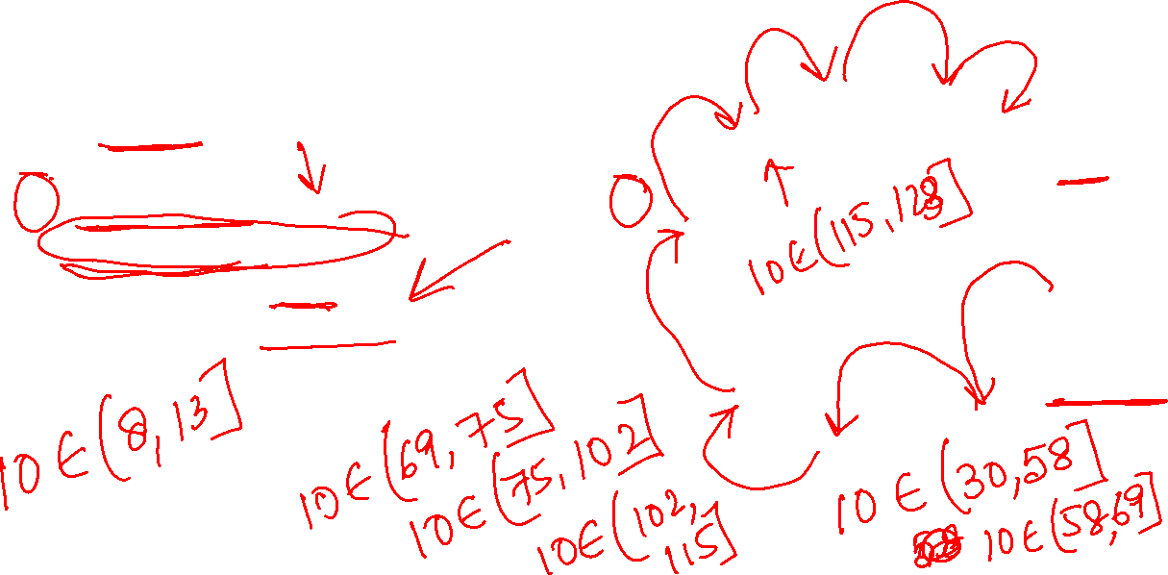
Simple Lookup
(variable)
integer: successor ← initial value;
(1) i.Locate_Successor(key), where key is not at i:
(1a) if key ∈ (i, successor] then
(1b) return (successor)
(1c) else return (successor.Locate_Successor(key)).
N123
N2
N8
K10
N115
N13
N102
N23
N30
N75
lookup(K10)
N58
N69

Slide 16
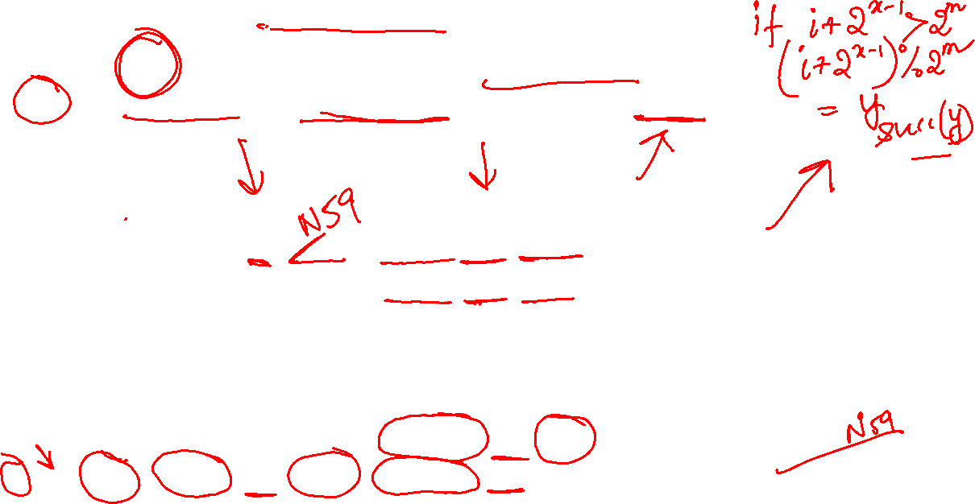
Scalable Lookup
each node i maintains a routing table, called finger table
x^{th} entry (1 ≤ x ≤ m) is the node identifier of the node succ(i+2^{x−1})
size of the finger table is bounded by m entries
N123
N2
N8
N8 8 + 1 = 9 – N13 8 + 2 = 10 – N13 8 + 4 = 12 – N13 8 + 8 = 16 – N23 8 + 16 = 24 – N30 8 + 32 = 40 – N58 8 + 64 = 72 – N75 | N58 58 + 1 = 59 – N69 58 + 2 = 60 – N69 58 + 4 = 62 – N69 58 + 8 = 66 – N69 58 + 16 = 74 – N75 58 + 32 = 90 – N102 58 + 64 = 122 – N123 | N102 102 + 1 = 103 – N115 102 + 2 = 104 – N115 102 + 4 = 106 – N115 102 + 8 = 110 – N115 102 + 16 = 118 – N123 102 + 32 = 134 – N8 102 + 64 = 166 – N58
N115
N13
N102
N23
N30
N75
N58
N69

Slide 17
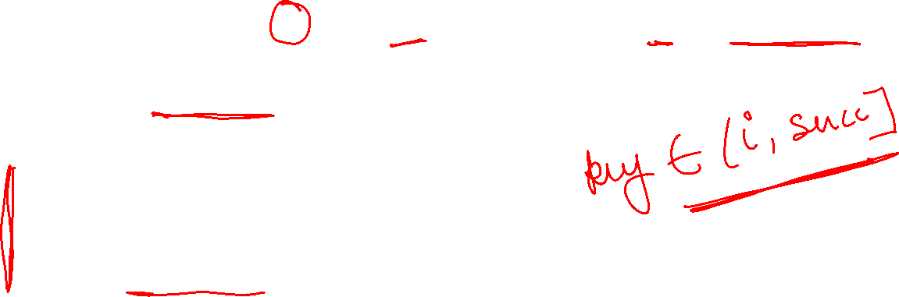
Scalable Lookup
search is highly scalable
for a query on key key at node i, if key lies between i and its successor, then key would reside at the successor and the successor’s address is returned
else the finger table is searched
(variables)
integer: successor ← initial value;
integer: predecessor ← initial value;
integer: finger[1…m];

Slide 18
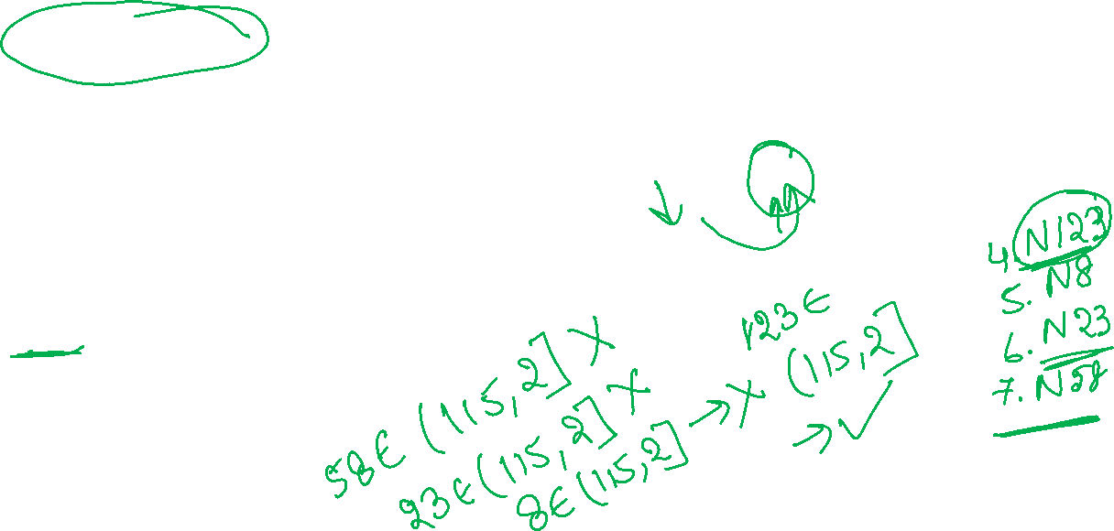
Scalable Lookup
N8 8 + 1 = 9 – N13 8 + 2 = 10 – N13 8 + 4 = 12 – N13 8 + 8 = 16 – N23 8 + 16 = 24 – N30 8 + 32 = 40 – N58 8 + 64 = 72 – N75 | N58 58 + 1 = 59 – N69 58 + 2 = 60 – N69 58 + 4 = 62 – N69 58 + 8 = 66 – N69 58 + 16 = 74 – N75 58 + 32 = 90 – N102 58 + 64 = 122 – N123 | N102 102 + 1 = 103 – N115 102 + 2 = 104 – N115 102 + 4 = 106 – N115 102 + 8 = 110 – N115 102 + 16 = 118 – N123 102 + 32 = 134 – N8 102 + 64 = 166 – N58
(1) i.Locate_Successor(key), where key is not at i:
(1a) if key ∈ (i, successor] then
(1b) return (successor)
(1c) else
(1d) j ← Closest_Preceding_Node(key);
(1e) return (j.Locate_Successor(key))
(2) i.Closest_Preceding_Node(key), where key ≠ i:
(2a) for count = m down to 1 do
(2b) if finger[count] ∈ (i, key] then
(2c) break();
(2d) return (finger[count])
N123
N2
K2
N8
N115
N13
N23
N102
N30
N75
N58
N69
lookup(K2)

Slide 19
References
Ajay D. Kshemkalyani, and Mukesh Singhal, Chapter 18, “Distributed Computing: Principles, Algorithms, and Systems”, Cambridge University Press, 2008.

Slide 20
Thank You

